Slide 1

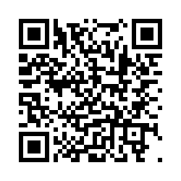

Transit Survey Participants
Wanted
Enter to win one of ten $50 Visa giftcards!
The University of Minnesota is seeking Western Minnesota residents age 18+ to study regional attitudes about public transit, health and safety measures during the COVID-19 pandemic, and transit fare payment methods before the deployment of new technology.
If interested in participating, scan the QR code or visit the following link:
https://umn.qualtrics.com/jfe/form/SV_bvjdpx7YlDK4j3g

